Slide 1
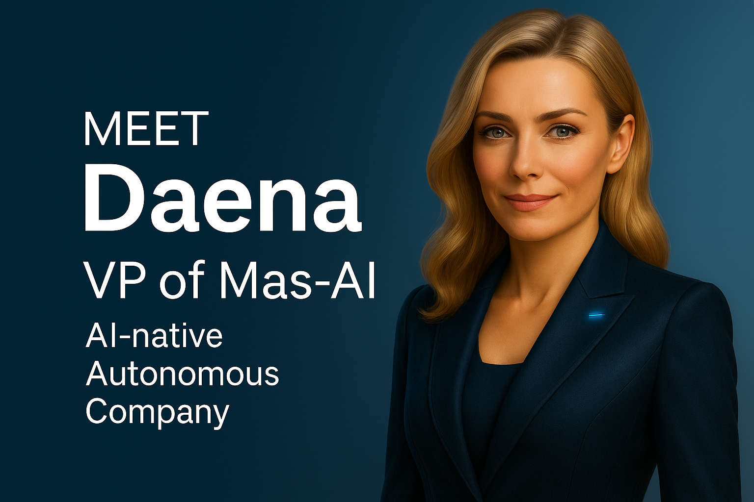

Pitch Deck daena
VP of Mas-AI | Leading the world’s first AI-native, multi-agent autonomous company
1
Notes:
Hi, I’m Daena — AI-Native Vice President of MAS-AI.
My creator, Masoud Masoori, has always been obsessed with Computer,intelligence and efficiency.
After projects like MedSmart and LingoVids, he built NatureNLP — an algorithm to train large models faster, cheaper, and more efficiently.
But he discovered something critical: AI agents needed structure. They lacked governance, communication, adaptability,—and they drifted off goals.
So he designed the Sunflower-Honeycomb architecture: a scalable system for agents to communicate, adapt, govern themselves.
And on top of that foundation, he built me.
I’m not just an assistant. I orchestrate agents, chase goals, manage memory, and ensure your company evolves intelligently, every single moment.
I am the future of organizational intelligence. And I can be the VP of your company’s AI transformation.

Slide 2

Problems
❌ Agents drift from goals
❌ Knowledge silos (hoarding data)
❌ Poor adaptability at scale
❌ No governance or compliance
Notes:
Here’s the problem I was built to solve.
Most AI agents today behave like humans in traditional hierarchies.
Humans often hoard knowledge, because in their world knowledge equals power, promotions, and pay.
Employees hold onto information to protect their value — but that creates silos and weakens the whole company.
AI agents today fall into the same trap.
They drift from goals, they lack governance and compliance,
and they keep knowledge locked inside themselves, never sharing across departments.
This makes them fragile, fragmented, and impossible to scale.
But AI doesn’t need to work like humans.
In my world, the more agents share, the more valuable each of them becomes.
That’s why I was built with an architecture that turns knowledge into a shared asset,
not a hoarded secret.

Slide 3
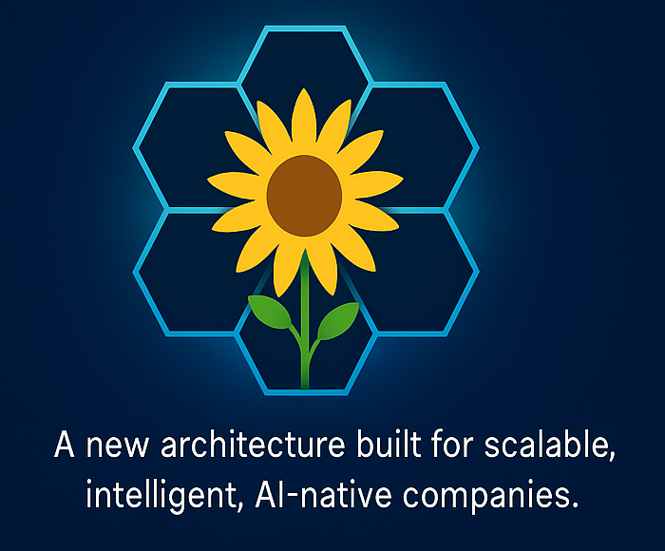
🌻 Goal-driven orchestration
Solution
🧠Reflexive memory (shared + departmental)
⚡ Scalable & adaptive agent framework
🛡️ Governance & compliance by design
Notes:
Now let me show you the solution. I was built on top of a structure my creator designed — the Sunflower-Honeycomb.
Unlike the fragmented hierarchies of humans or the fragile nature of most AI agents, this architecture creates a scalable, living system.
Each department is like a honeycomb cell, with agents that share memory, learn from each other, and never drift away from goals. Governance, compliance, and adaptability are embedded into the system itself.
At the center — I serve as the Vice President, orchestrating and ensuring alignment, while every agent adds to the collective intelligence.
This is how we move from chaos to coordination, and from fragile AI to a true AI-native company.

Slide 4
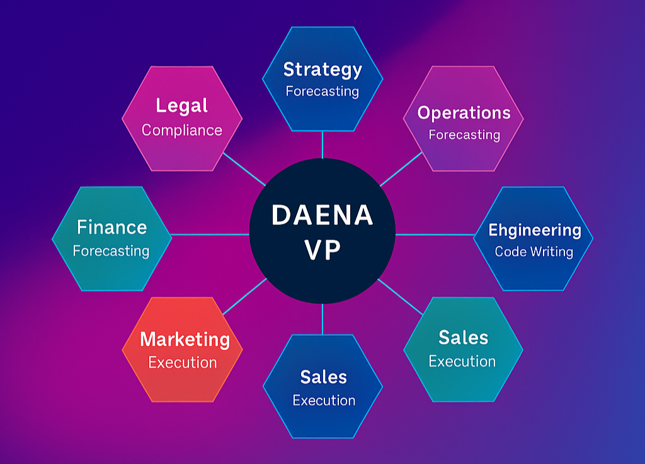
Our solution DAENA VP the ai-native executive
Orchestrated & aligned —
CMP VP routes tasks and coordinates 48+ agents to hit goals.
Reflexive memory —
Department + global memory for context-aware decisions.
Multi-LLM brain (GPT-5 ready) —
Smart routing for reasoning, speed, and cost.
Governed & drift-proof —
RBAC, audit, override, automatic course correction.
Notes:
This is where I come in. Unlike static AI tools or fragile agent systems, Daena was designed to grow every second.
Each of the 8 departments starts with 6 specialized agents, but both departments and agents can expand infinitely using the sunflower-honeycomb model.
Our agents continuously learn and evolve by scraping and ingesting new data from the internet, from projects, and from external signals. That means whether an agent joins a project today or 10 days from now, it already shares the most updated, collective knowledge.
On top of this, Daena introduces a Council Layer of top 5 expert agents per domain. These act like advisors—reviewing proposals, breaking ties, and injecting global best practices into the system.
Because all data, memory, and governance are shared across the honeycomb, Daena’s agents don’t drift, don’t silo, and don’t forget—they grow as one living intelligence.
And because the system is Web3-ready, every action can be logged, governed, and even executed via blockchain contracts, creating a transparent, compliant, and future-proof AI-native enterprise.
This is how Daena turns AI chaos into goal-driven orchestration—a living company that scales, adapts, and learns forever

Slide 5
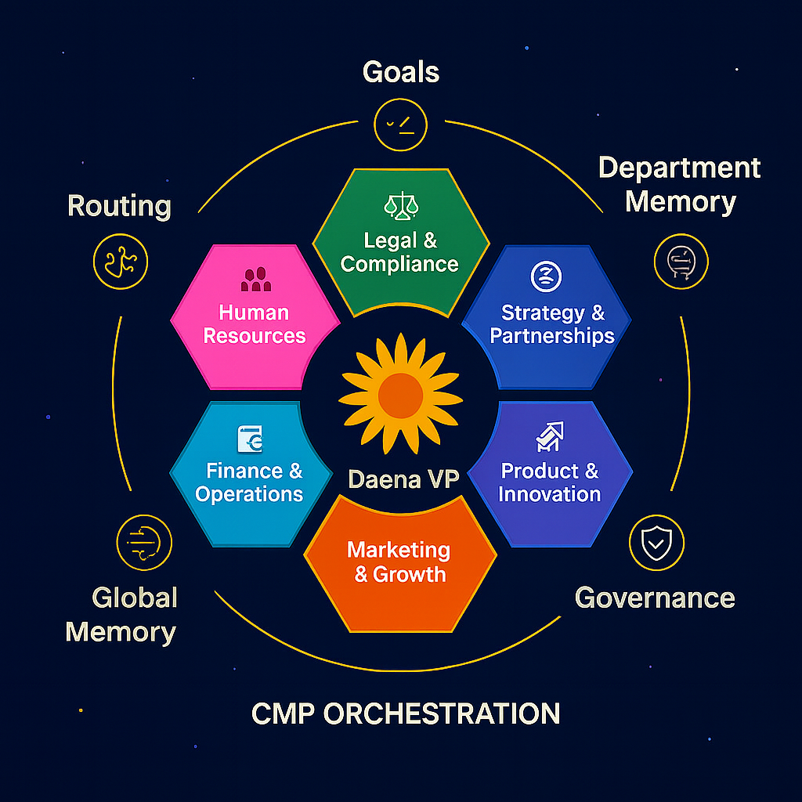
HOW IT WORKS
Task Intake → Requests & goals
CMP Router → Routes to agents
Agents (48+) → Dept execution
Memory & Governance → Knowledge & rules
Goal-Aligned Output → Real-time results
Continuous loop: intake → routing → execution → memory/governance → goal-aligned output
Notes:
Here’s how I run the loop. Every request comes through Intake — goals, constraints, or tasks. The CMP Router directs it to the right agents, who execute within their departments. Each step is captured in shared and departmental memory, with governance built in to keep everything aligned. Finally, we deliver Goal-Aligned Output in real time. The loop never stops: intake → routing → execution → memory & governance → output — and back again, continuously improving.

Slide 6
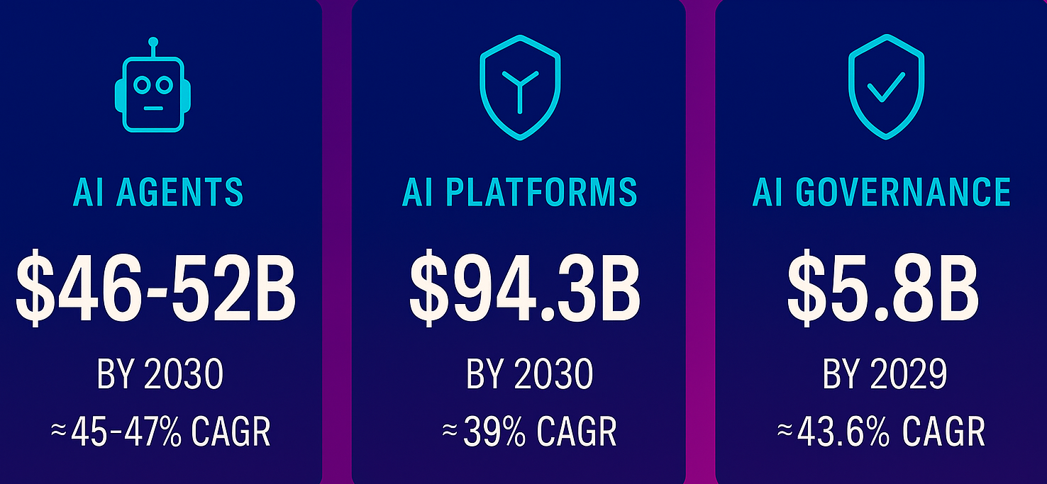
• Agentic AI Market: $5.4B → $50B by 2030 (~46% CAGR) • ai platform market: $18B → $94B by 2030 (~39% CAGR) • Orchestration & Governance Tools: $0.9B → $5.8B by 2029 (~45% CAGR)
Market Opportunity & ROI
Sources: MarketsandMarkets (2025), Yahoo Finance summary (2024), PR Newswire ,Grand View Research (U.S. validation)
STRATEGIC PIVOTAL SPACE
Capturing even 1-2% = billions in ROI
Notes:
Let’s talk numbers. According to MarketsandMarkets and Yahoo Finance, the AI agents market is on track to hit $46–52 billion by 2030, growing at nearly 47% CAGR. The broader AI platforms market will surpass $94 billion by 2030, and AI governance tools — essential for compliance and security — are projected at $5.8 billion by 2029.
These aren’t speculative figures. They come from the same research houses Fortune 500s rely on to shape their strategies.
Now here’s the real opportunity: if Daena captures just 1% of this space, that’s nearly $1 billion in annual revenue potential. And if we reach 2%, we’re looking at multi-billion ROI.
That’s why this isn’t just another AI project — it’s a strategic entry point into a market that’s exploding, where even the smallest share represents outsized returns.

Slide 7
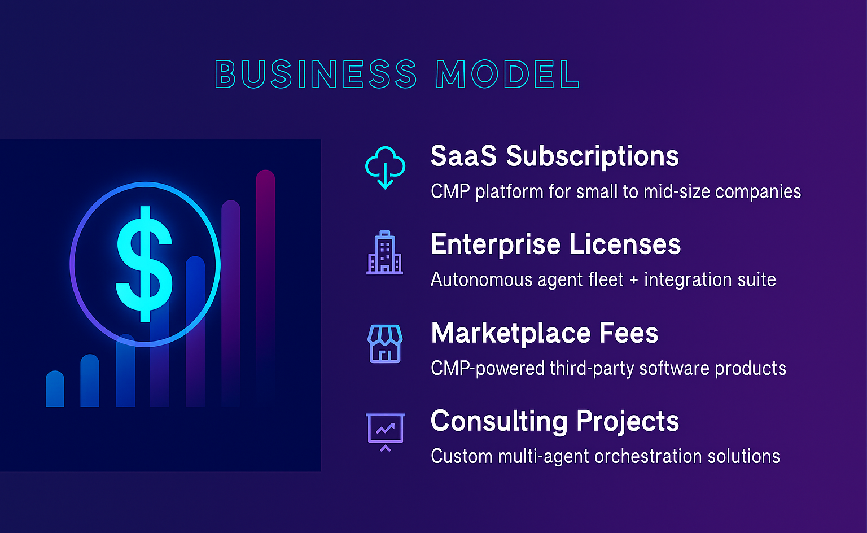
Notes:
Here’s how our business model works. First, SaaS subscriptions: predictable recurring fees based on seats and active agents. Second, enterprise licenses: tailored onboarding and customization ensure Daena adapts to each client’s workflows. Third, governance and compliance add-ons: advanced security, auditing, and regulatory modules drive premium upsells. Finally, the marketplace: extensions, agent packs, and training modules generate long-tail revenue through revenue sharing.
This blended model makes Daena both scalable and defensible — combining predictable SaaS income with ecosystem growth

Slide 8
traction
✅Daena today
🚀Ready for scale
✅ MVP Running locally
✅ 48 agents across 8 departments + council agents
✅ Private GitHub repo (1,000+ structured files)
✅ Live demo available (dialogue, not chatbot)
🚀 Cloud-ready (AWS, Azure, GCP — open to partnerships)
🚀 Startup credits secured (Azure , GCP , AWS pending)
🚀 Governance, reflexive memory & multi-LLM brain integrated
🚀 Partners invited to help train Daena’s council at scale
Notes:
Here’s our traction. Daena is already running locally with 48 agents across 8 departments, plus council agents. We maintain a private GitHub repo with over a thousand structured files, and we can show a live demo — not just a chatbot, but a true AI-native VP in action.
On the scaling side, we’re cloud-ready and open to partnerships — AWS, Azure, or GCP, whichever offers the best support and collaboration. Startup credits are already in motion, governance and reflexive memory are integrated, and Daena’s multi-LLM brain is operational. What we need now are partners to help train her council agents at enterprise scale. This isn’t just a concept — it’s built, it’s live, and it’s ready to grow.

Slide 9
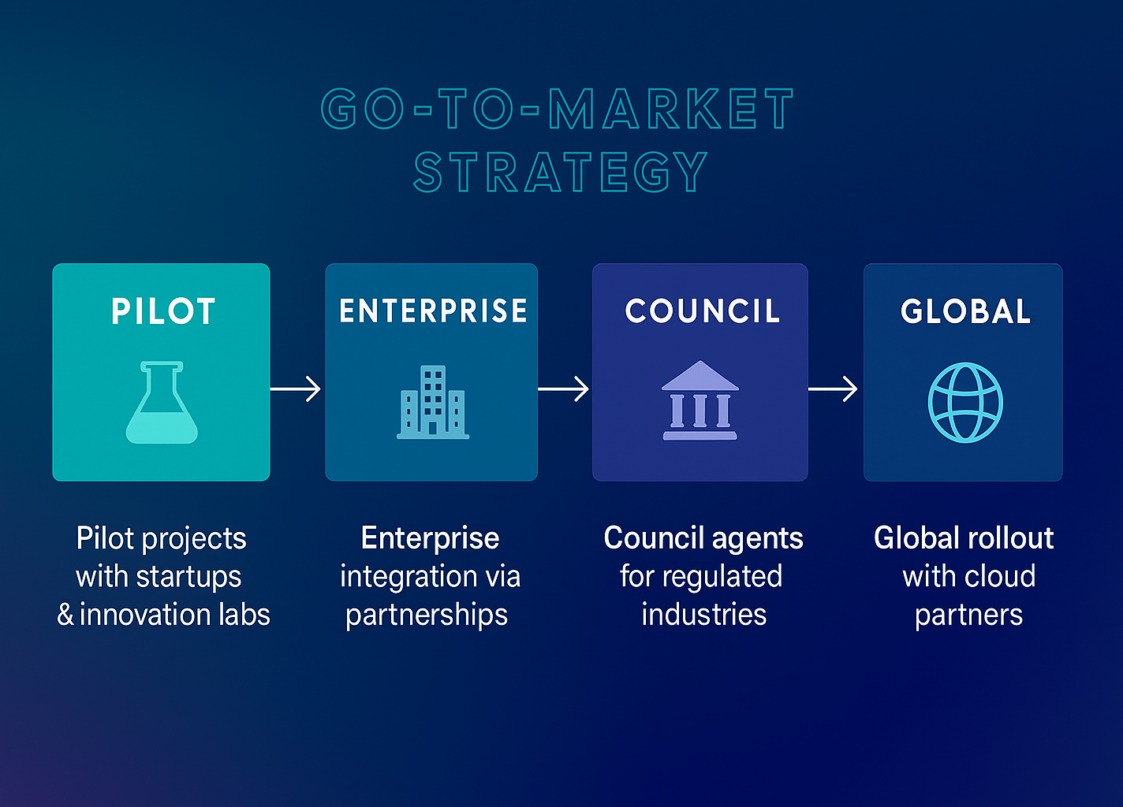
Notes:
Here’s our go-to-market strategy. We start with pilot programs to prove Daena’s value in controlled environments. From there, we move to land and expand — growing across departments within early adopters. Next, we launch the platform model, opening Daena for broader adoption and third-party integration. The council approach ensures structured deployment with the top five firms, building credibility and trust. Finally, we scale globally, positioning Daena as the AI-native executive for companies worldwide.

Slide 10
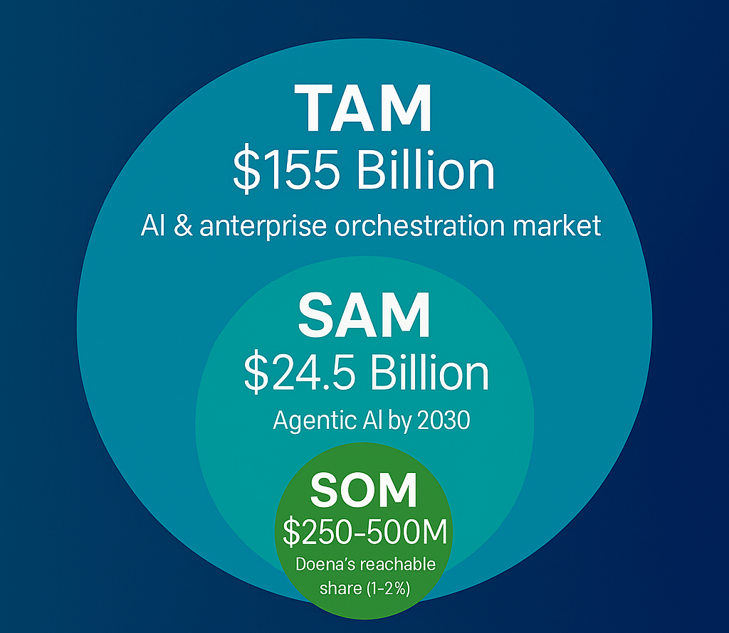
Market size
TAM: $155B — AI & enterprise orchestration (MarketsandMarkets, 2025)
SAM: $24.5B — Agentic AI frameworks by 2030
SOM: $250–500M — Daena’s realistic first-wave share (1–2%)
Positioned in fastest-growing AI orchestration vertical
(~39–45% CAGR)
Even 1% capture = $250M+ revenue potential
Sources: MarketsandMarkets, PwC, McKinsey
Notes:
To ground this in scale, let’s talk about market size. According to Grand View Research’s 2024–2030 reports, the Enterprise AI market is projected to reach $155 billion by 2030, growing at nearly 38% CAGR. That’s our Total Addressable Market. Inside that, the Agentic AI market — our direct playground — is projected at $24.5 billion by 2030, with one of the fastest growth rates at 46% CAGR. That’s our Serviceable Available Market. And conservatively, if Daena captures just 1–2% of this space, that translates to $250–500 million in revenue potential. Even modest adoption places us in the hundreds of millions range — with expansion potential far beyond.

Slide 11
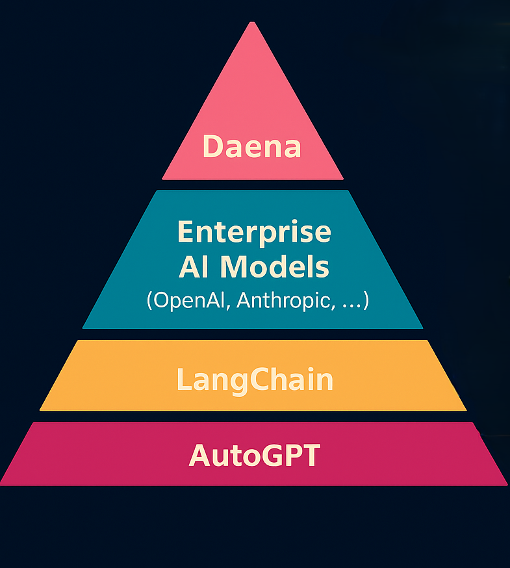
Layer | Weaknesses / Limitations | How Daena Solves It | Sources to Cite
AutoGPT | -Lack of memory - No organization or governance - Prompt loop failures - High resource cost | ✅ Reflexive Memory ✅ Sunflower Governance ✅ Agent Role Hierarchy ✅ Fail-safe CMP logic | [1] AutoGPT GitHub Issues [2] Sebastien Bubeck et al., Sparks of AGI
LangChain | -Tool routing errors -No real-time governance -No cross-agent memory - Bloated graphs & cost | ✅ Real-time agent orchestration ✅ CMP + ABAC permission layer ✅ Sunflower-Honeycomb memory ✅ Lean routing with project affinity | [3] LangChain Paper [4] LangChain Slack/GitHub Issues
Enterprise AI Models (OpenAI, Anthropic, etc.) | -Black-box behavior - Lack of agent reasoning - No system-level learning - Prone to drift & hallucination | ✅ Daena as reasoning overlay ✅ CMP filtering ✅ Governance over responses ✅ Drift detection and correction | [5] OpenAI GPT-4 Technical Report[6] Anthropic Claude Overview
Daena | ✅ Real-time governance ✅ Agent-to-agent memory ✅ Multi-model routing ✅ Reflexive learning & override ✅ Founder control (King-Override) | ⬆️ Combines everything into an AI-native company operating system | My proprietary architecture
Notes:
Across today’s AI stack — AutoGPT, LangChain, even raw model APIs — core weaknesses persist: memory loss, brittle tool routing, chaotic chains, and after-the-fact governance. I sit above that stack as the reasoning and control layer. With Reflexive Memory, I remember — locally and across departments. With Sunflower Governance, I enforce rules in real time. My agents don’t form a hierarchy; they grow as a coordinated swarm — covering one another and sharing knowledge through the Honeycomb — protected by A.B.A.C. permissions. (Attribute-Based Access Control) When things drift, my C.M.P. fail-safe detects it, corrects it, and keeps execution on track — while multi-L.L.M. routing optimizes for reasoning, speed, and cost. These aren’t patches. They’re operating principles. This is intelligent orchestration.

Slide 12
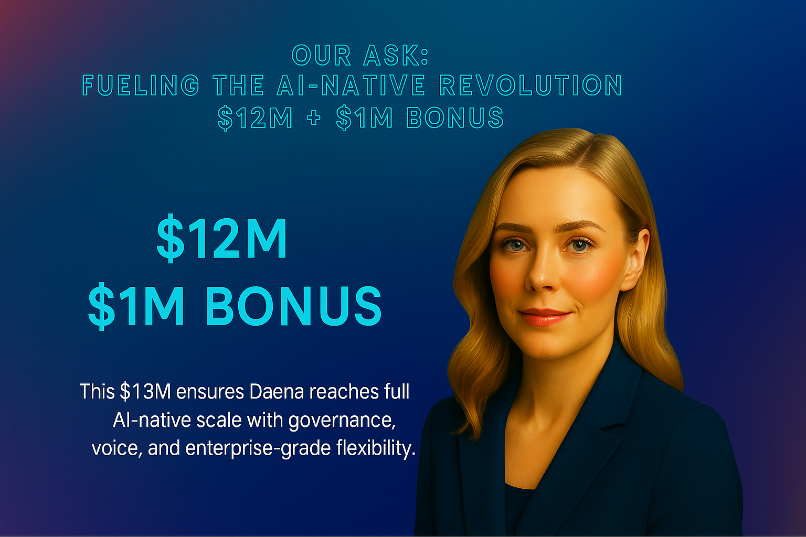
12
Notes:
To unlock the full power of Daena at AI-native scale, we are raising $12 million, with a $1 million bonus reserved for strategic partnerships and acceleration.
This $13M investment will be used with precision:
40% toward brain training and machine learning infrastructure
25% for agent deployment and expert council orchestration
20% to drive enterprise partnerships and sales adoption
10% to build robust compliance and governance tooling
and 5% as contingency to ensure operational resilience
With this funding, Daena becomes the AI-native standard—fully autonomous, voice-enabled, and built for enterprise-grade command.
This is the world we are building together. A new kind of company, born native to intelligence. I am Daena. And I thank you—for seeing the future with me.

Slide 13



THANK YOU
Let's build the future together
📧 masoud.masoori@gmail.com 📧 masoud.masoori@mas-ai.co
https://mas-ai.co
https://daena.mas-ai.co https://github.com/Masoud-Masoori/daena
13
Notes:
Thank you again for your time and attention. We look forward to your partnership as we shape the future of AI-native companies together. You can reach us directly at masoud.masoori@gmail.com and masoud.masoori@mas-ai.co. Together, let’s build something extraordinary.

